Slide 1
A Simple Point of “ u e ”
Learn how simple and easy it is to build sophisticated
single-page web apps using Vue.js
Jason LuBean
October 9, 2018

Slide 2
Jason LuBean
Web Developer at FamilySearch
Tree Web Team
jlubean@familysearch.org
Source code: https://github.com/jlubean/clue-card

Slide 3
What is Vue.js?
The Progressive JavaScript Framework
Approachable
Already know HTML, CSS and JavaScript? Read the guide and start building things in no time!
Versatile
An incrementally adoptable ecosystem that scales between a library and a full-featured framework.
Performant
20KB min+gzip Runtime Blazing Fast Virtual DOM Minimal Optimization Efforts
Notes:
What is Vue.js? It is a progressive JavaScript framework for building user interfaces. Unlike other monolithic frameworks, Vue is designed from the ground up to be incrementally adoptable. The core library is focused on the view layer only, and is easy to pick up and integrate with other libraries or existing projects.
On the other hand, Vue is also perfectly capable of powering sophisticated Single-Page Applications when used in combination with modern tooling and supporting libraries.
After developing web apps in Angular.js for years, I have found Vue.js to be refreshingly simple, yet powerful.

Slide 4
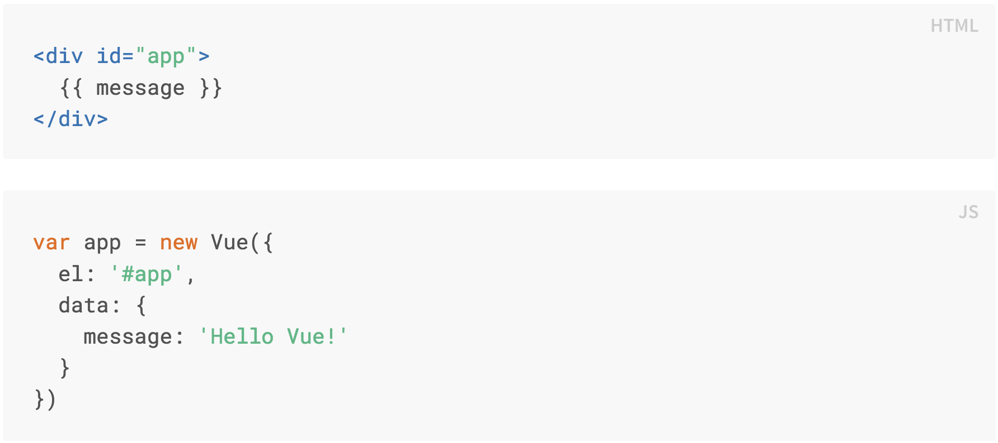
Declarative Rendering
Notes:
At the core of Vue.js is a system that enables us to declaratively render data to the DOM using straightforward template syntax.
This looks pretty similar to rendering a string template, but Vue has done a lot of work under the hood. The data and the DOM are now linked, and everything is now reactive.

Slide 5
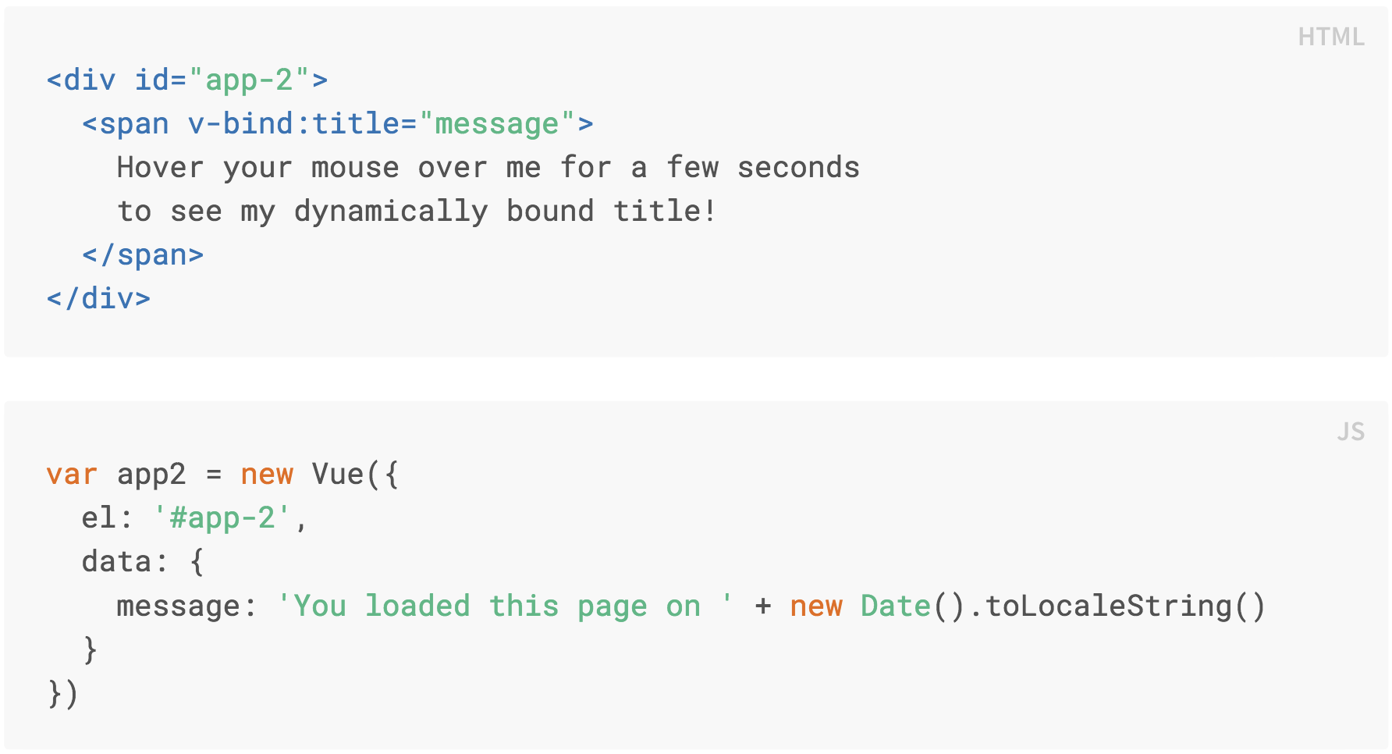
Declarative Rendering
Notes:
In addition to text interpolation, we can also bind element attributes like this.
The v-bind attribute is called a directive. Directives are prefixed with v- to indicate that they are special attributes provided by Vue. They apply special reactive behavior to the rendered DOM.
Here, it is basically saying “keep this element’s title attribute up-to-date with the message property on the Vue instance.”

Slide 6
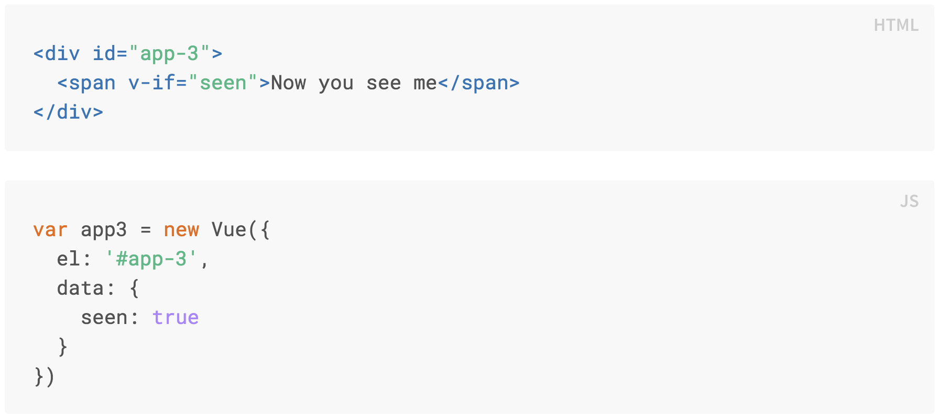
Conditionals
Notes:
We can bind data to not only text and attributes, but also the structure of the DOM. Using the v-if directive, we can conditionally display an element. In this case, when seen is true, then the span element is displayed.
There are quite a few other directives, each with its own special functionality.

Slide 7
Loops
Notes:
For example, the v-for directive can be used for displaying a list of items using the data from an Array:

Slide 8
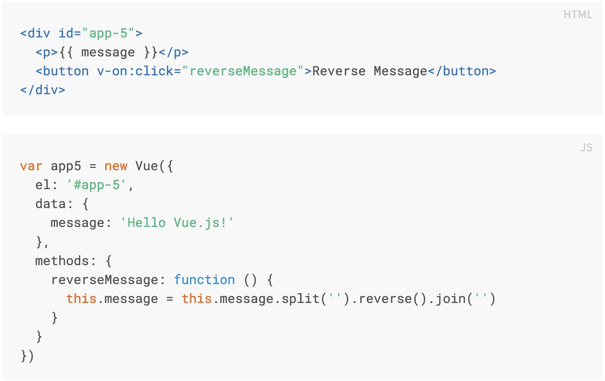
Handling User Input
Notes:
We can use the v-on directive to attach a click event listener that invokes a method on a Vue instance.
In this method, we update the state of our app without touching the DOM.
All DOM manipulations are handled by Vue, and the code you write is focused on the underlying logic.

Slide 9
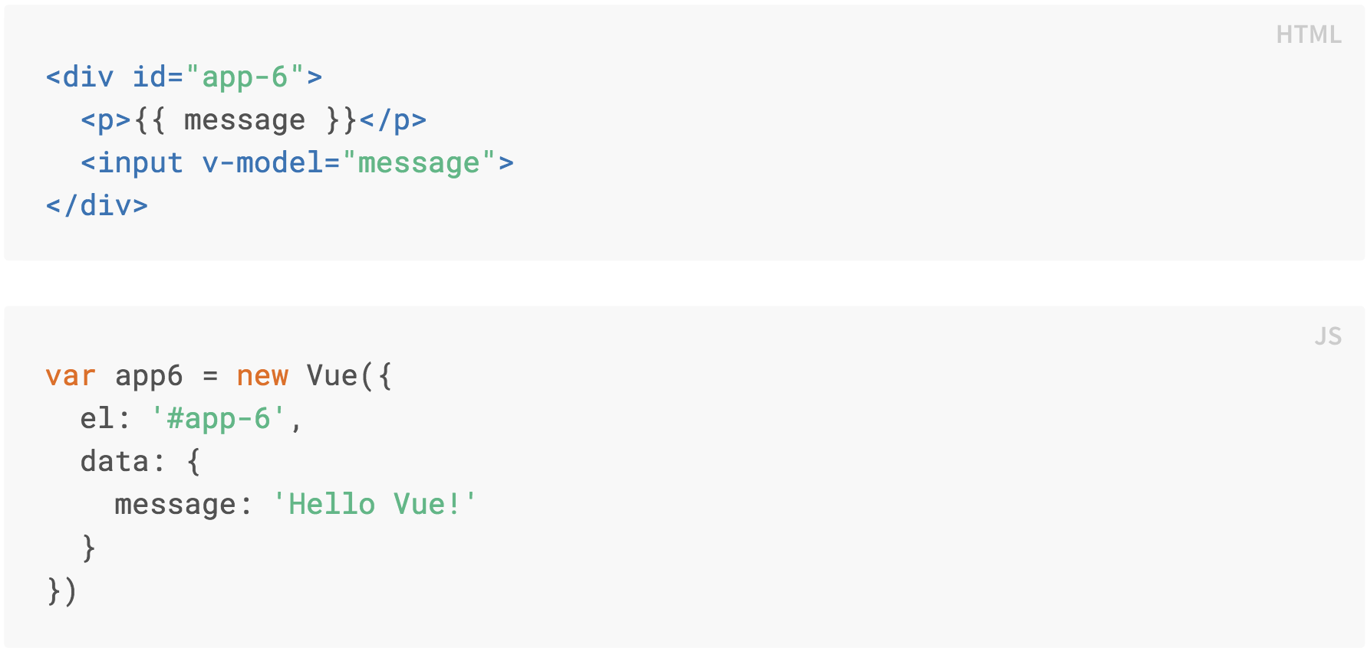
Handling User Input
Notes:
Vue also provides the v-model directive that makes two-way binding between form input and app state a breeze.

Slide 10
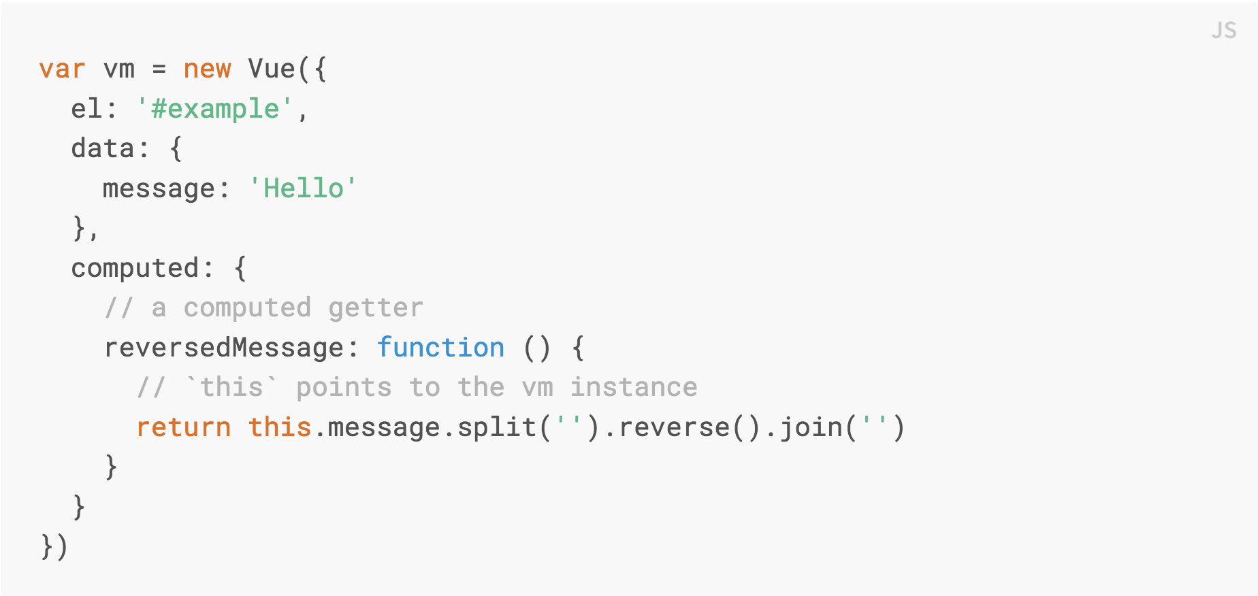
Computed Properties
Notes:
Here we have declared a computed property named reversedMessage. The function we provided will be used as the getter function for the property reversedMessage.
The value of reversedMessage is always dependent on the value of message.

Slide 11
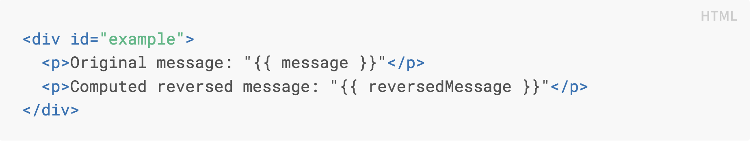

Computed Properties
Notes:
We can use computed properties in the template just like regular properties. Whenever the value of message changes, the value of reversedMessage will change and be rendered in the DOM.

Slide 12
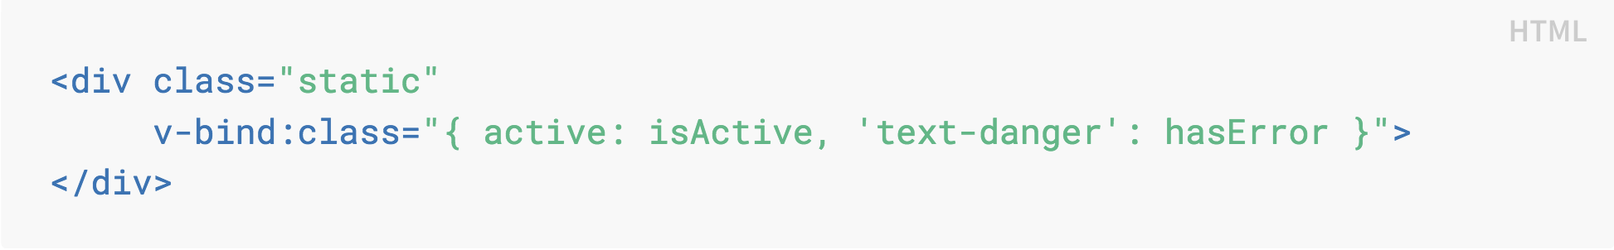
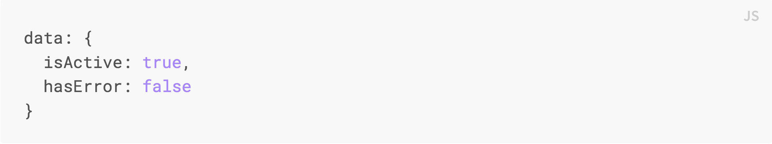
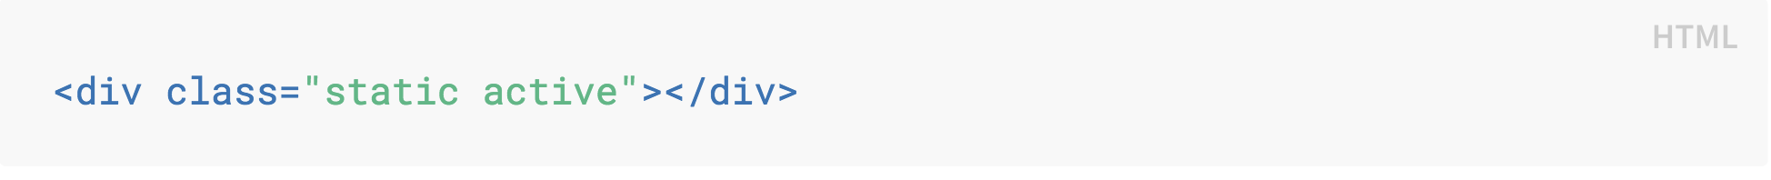
Class Attribute Bindings
Will render:
Notes:
We can pass an object to v-bind:class to dynamically toggle classes. The presence of the active class will be determined by the truthiness of the data property isActive.

Slide 13

Composing with Components
Notes:
The component system in Vue is an abstraction that allows us to build large-scale applications composed of small, self-contained, and often reusable components. Almost any type of application interface can be abstracted into a tree of components.

Slide 14
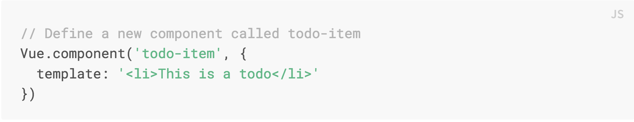
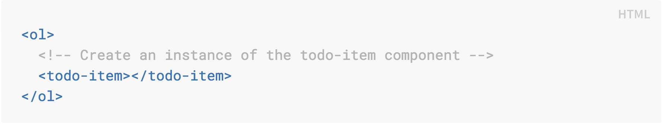
Composing with Components
Notes:
In Vue, a component is essentially a Vue instance with pre-defined options. Registering a component in Vue is straightforward. But this would render the same text for every todo. We should be able to pass data from the parent scope into child components. Let’s modify the component definition to make it accept a property:

Slide 15
Composing with Components
Notes:
Now our custom component todo-item accepts a ‘todo’ property—or prop—and the template will display the text property of the todo Now we can pass the todo into each repeated component using v-bind:todo.
This is a contrived example, but we have managed to separate our app into two smaller units, and the child is reasonably decoupled from the parent via the props interface. We can now further improve our <todo-item> component with a more complex template and logic without affecting the parent app.
In a large application, it is necessary to divide the whole app into components to make development manageable.
Vue components, like our todo-item component, are very similar to Custom Elements, which are part of the Web Components Spec. Vue’s component syntax is loosely modeled after the spec. For example, Vue components implement the Slot API.

Slide 16
Single File Components
Disadvantages of global components defined using Vue.component, followed by new Vue({ el: ‘#container’}):
Global definitions force unique names
String templates lack syntax highlighting and multi-line HTML
No CSS support
No build step
Notes:
In many Vue projects, global components will be defined using Vue.component, followed by new Vue({ el: '#container' }) to target a container element in the body of every page.
This can work very well for small to medium-sized projects, where JavaScript is only used to enhance certain views. In more complex projects however, or when your frontend is entirely driven by JavaScript, these disadvantages become apparent:
Global definitions force unique names for every component
String templates lack syntax highlighting and require ugly slashes for multiline HTML
No CSS support means that while HTML and JavaScript are modularized into components, CSS is conspicuously left out
No build step restricts us to HTML and ES5 JavaScript, rather than preprocessors like Pug and Babel

Slide 17
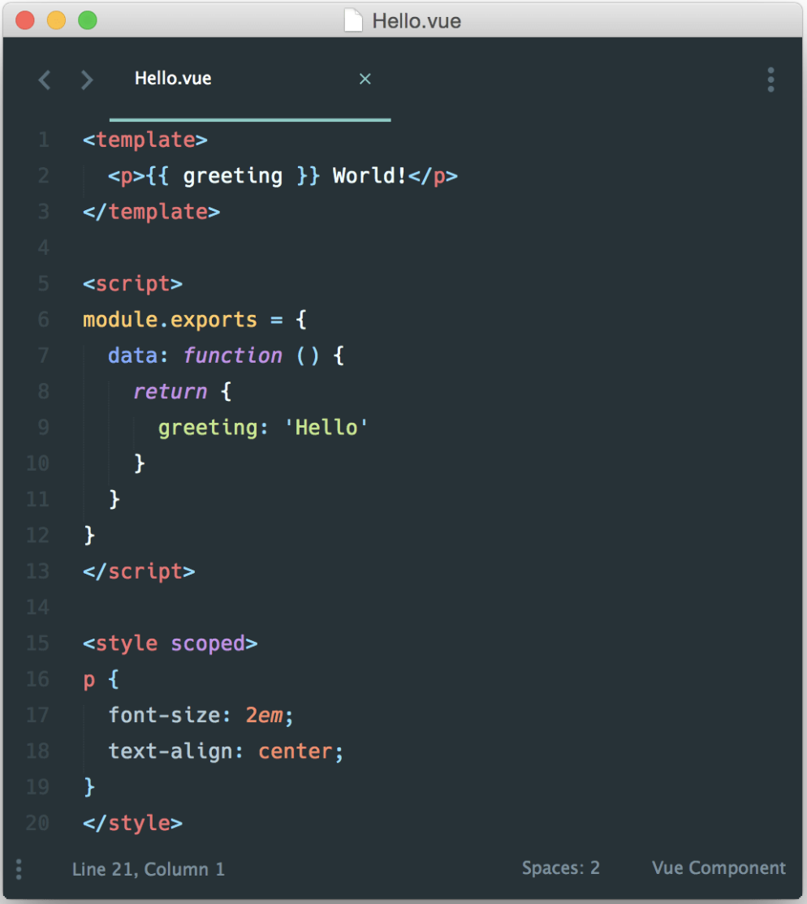
Single File Components
Complete syntax highlighting
CommonJS modules
Component-scoped CSS
Notes:
All of these are solved by single-file components with a .vue extension, made possible with build tools such as Webpack or Browserify.
Now we get:
Complete syntax highlighting
CommonJS modules
Component-scoped CSS
As promised, we can also use preprocessors such as Pug, Babel (with ES2015 modules), and Sass for cleaner and more feature-rich components.
One important thing to note is that separation of concerns is not equal to separation of file types. Instead of dividing the codebase into three huge layers that interweave with one another, it makes much more sense to divide them into loosely-coupled components and compose them.
Inside a component, its template, logic and styles are inherently coupled, and collocating them actually makes the component more cohesive and maintainable.

Slide 18
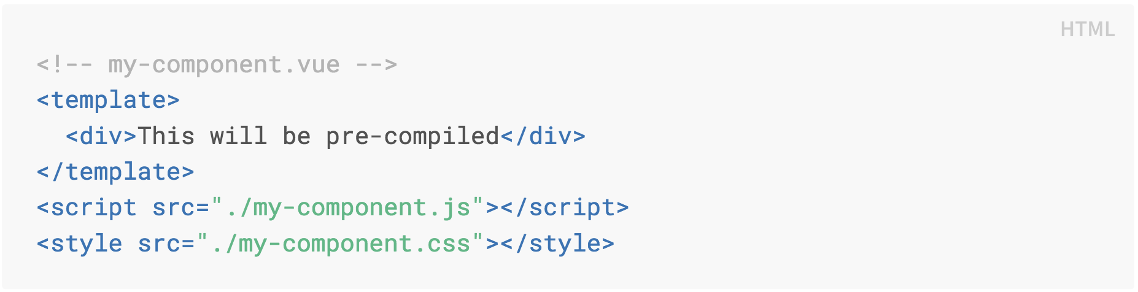
Single File Components
Notes:
Even if you don’t like the idea of Single-File Components, you can still leverage its hot-reloading and pre-compilation features by separating your JavaScript and CSS into separate files.

Slide 19
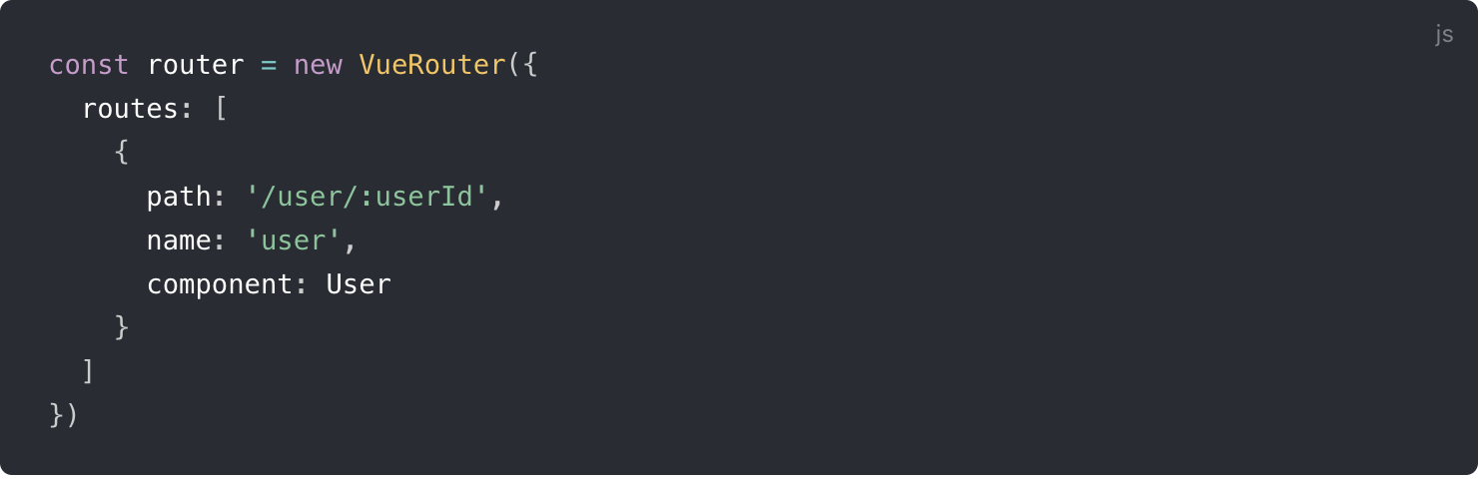
Routing
<a href=“#/user/123”>User</a>
Notes:
Creating a Single-page Application with Vue + Vue Router is simple. When adding Vue Router to the mix, all we need to do is map our components to the routes and let Vue Router know where to render them. In this example, we have a User component that is a view that maps to the URL path of “/user/:userId”.
Vue Router comes with a router-link component that you can use to help create a link to a route. It will essentially render an anchor tag with an href of “#/user/123”. You can also programmatically go to the route using the router.push method.

Slide 20

Clue: Classic Detective Game
https://goo.gl/images/57U8wP

Slide 21
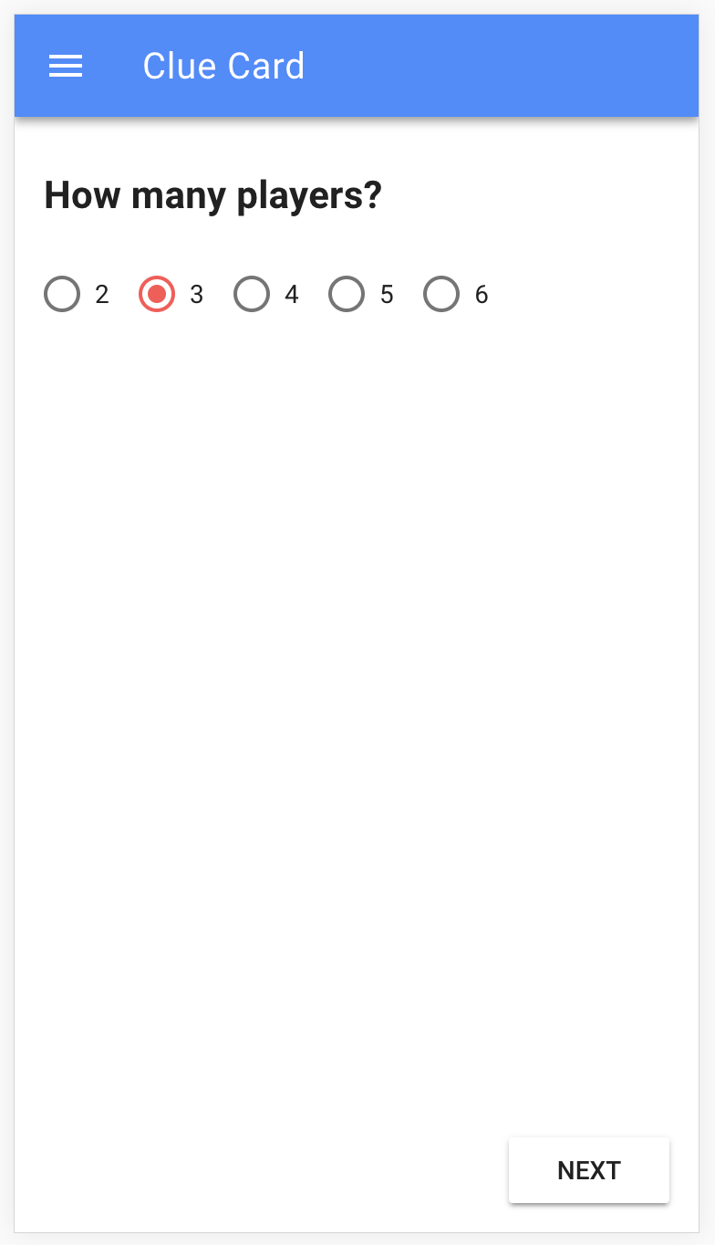
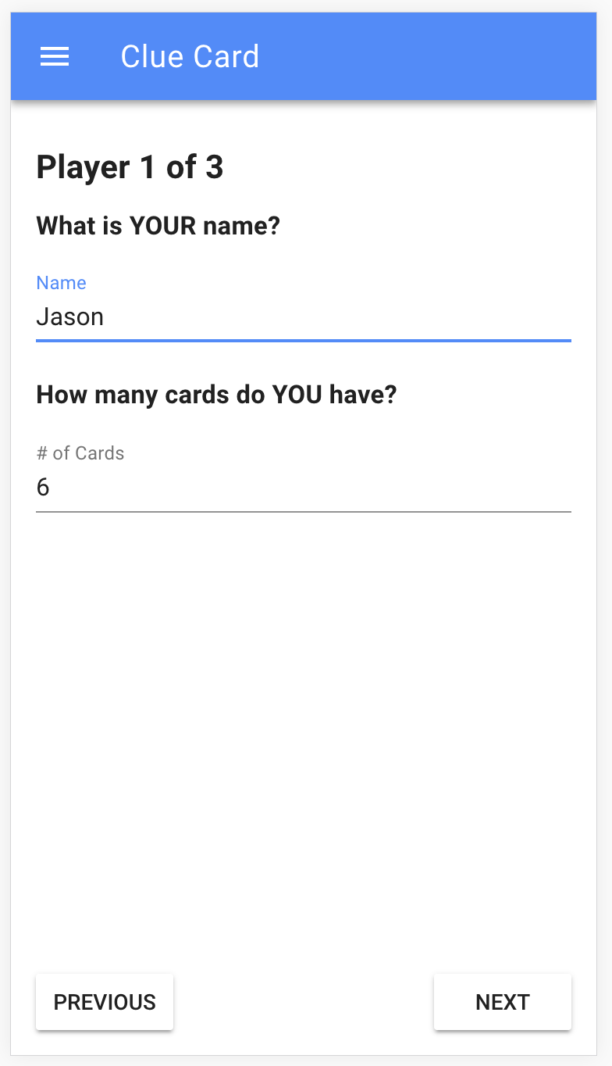
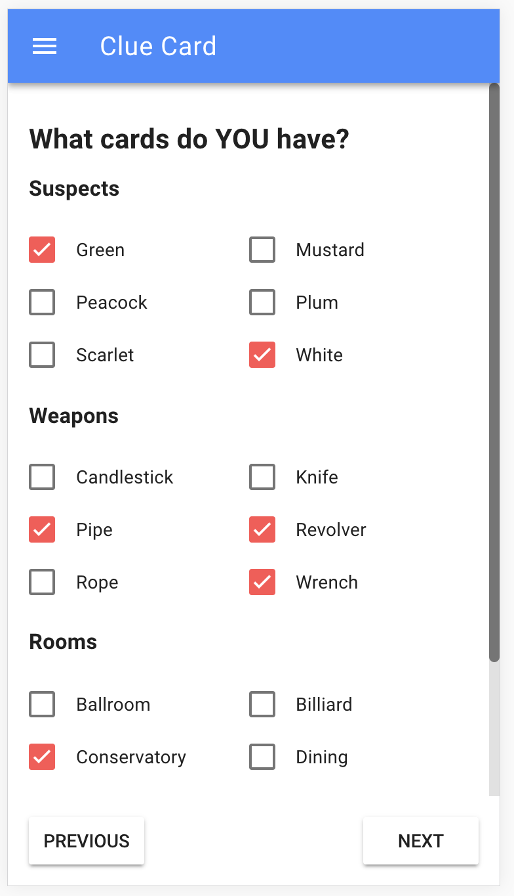
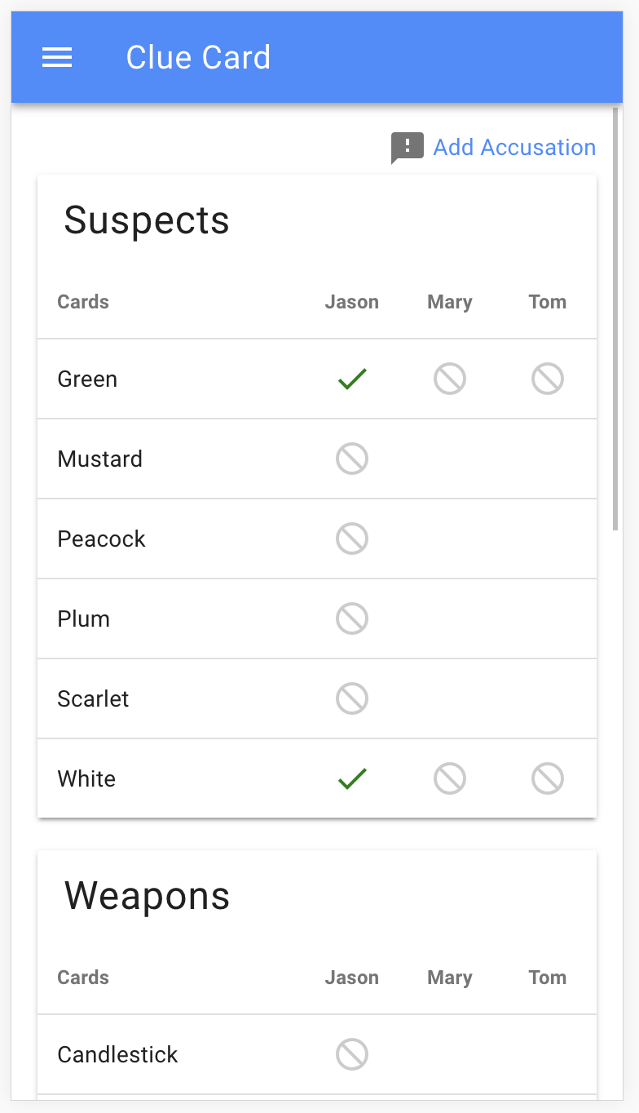
Clue Card

Slide 22
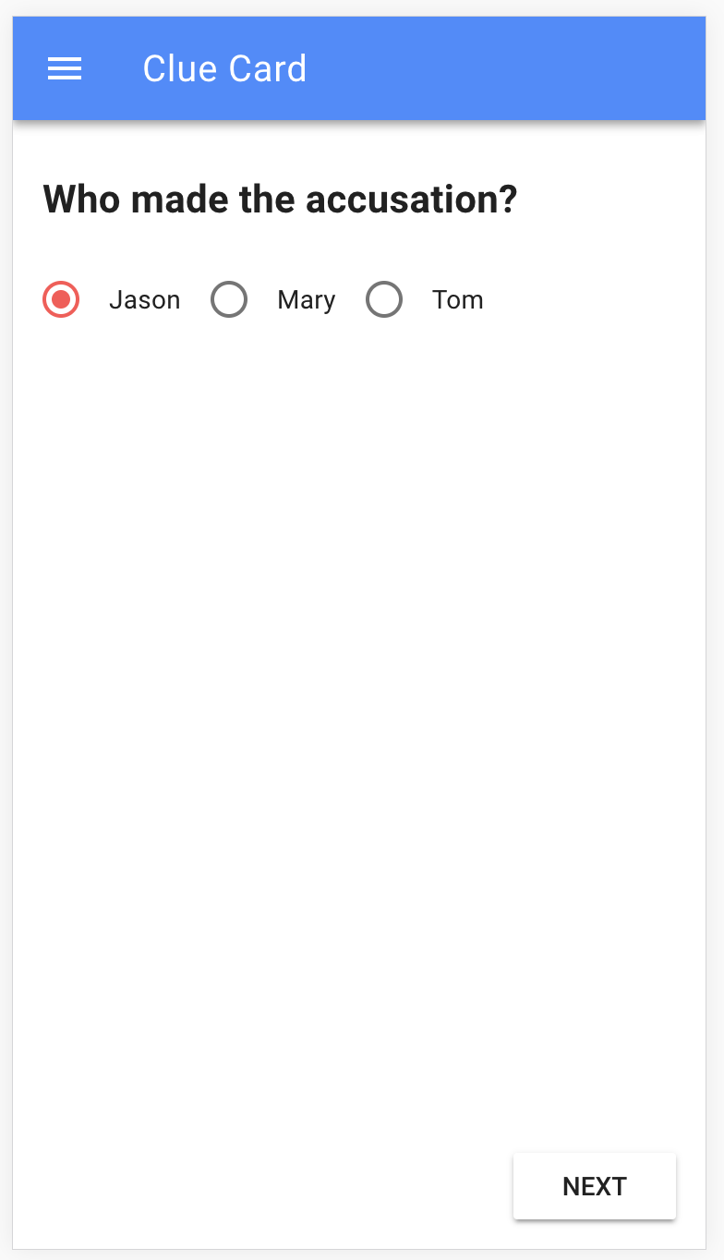
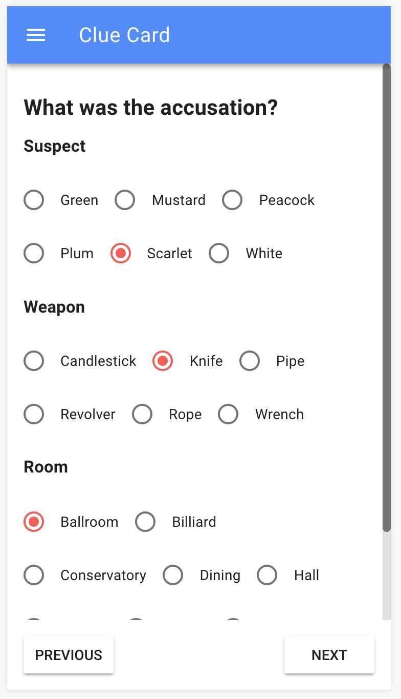
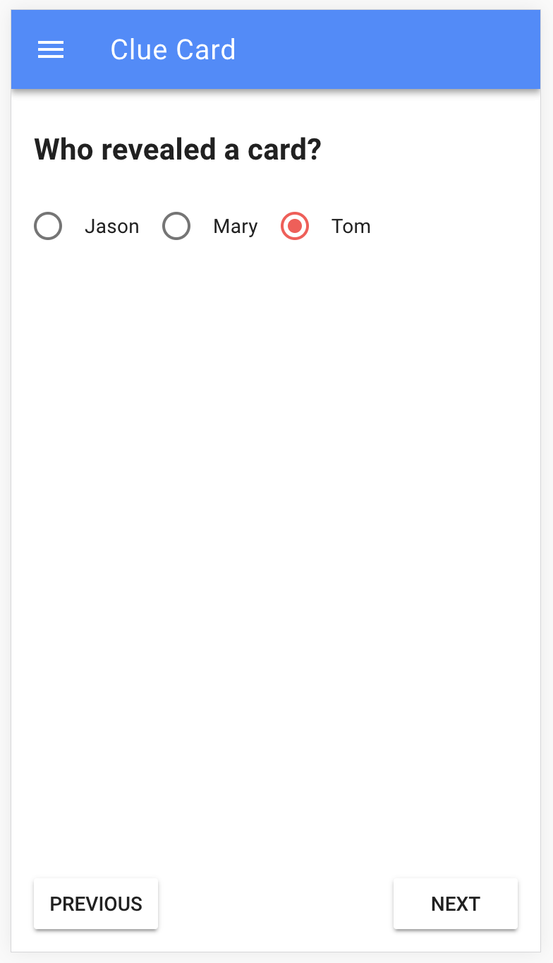
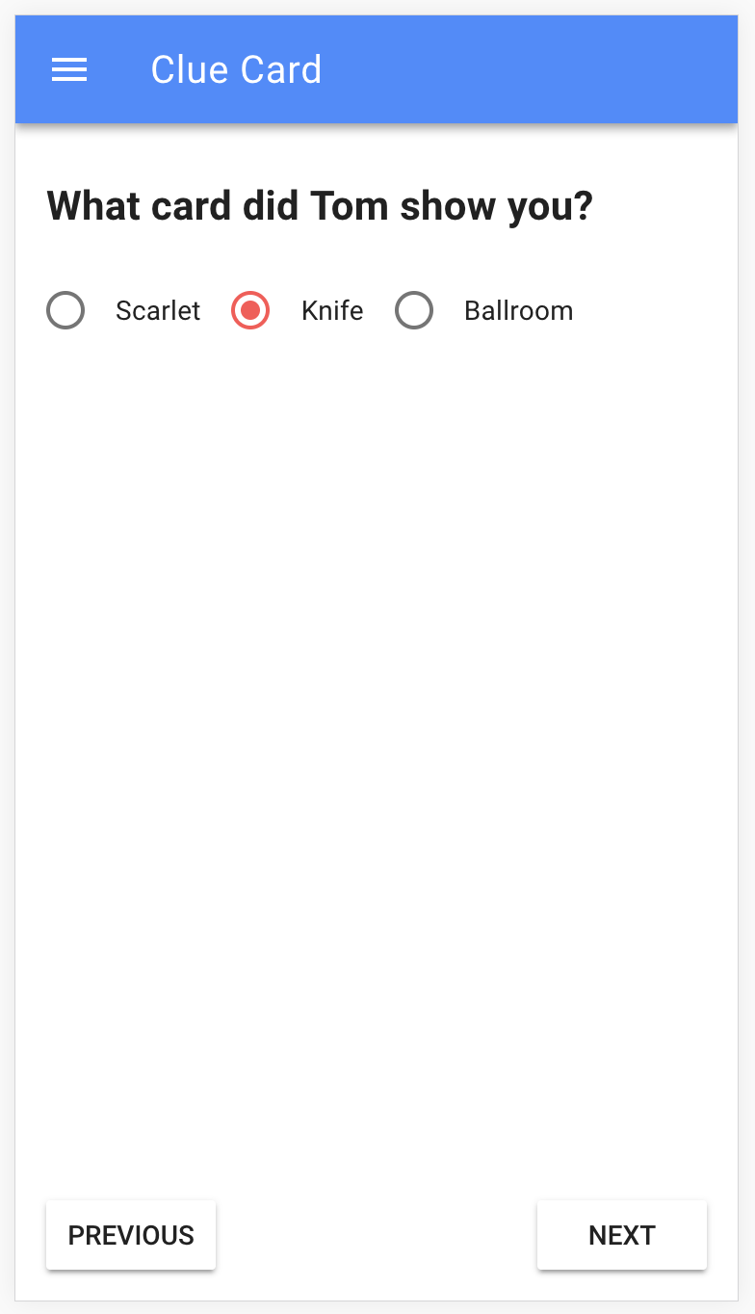
Clue Card

Slide 23
Vue.js Project Setup
npm install -g @vue/cli
yarn global add @vue/cli-init
vue init webpack clue-card
cd clue-card
npm install
npm start

Slide 24
Vue.js Project Setup
npm install vue-material --save
Add to src/menu.js
import VueMaterial from 'vue-material'; import 'vue-material/dist/vue-material.min.css'; import ‘vue-material/dist/theme/default.css';
Vue.js Guide: https://vuejs.org/v2/guide/
Vue Material: https://vuematerial.io/components/app

Slide 25
Vue.js Project Demo
Demo

Slide 26
Jason LuBean
Web Developer at FamilySearch
Tree Web Team
jlubean@familysearch.org
Source code / slides: https://github.com/jlubean/clue-card

